Slide 1


EE 620: Standards and Regulations of
Communication Technology
Spectrum Management
    Supervisor
    Dr. Saud bin Saeed
    Made by
  Alwaleed A. Abdulwahed

Slide 2
1 | Introduction to Spectrum Management
2 | Spectrum Distributions in Saudi Arabia
3 | What is the benefits of Spectrum Management?
4 | Regional Distribution and Interference
Agenda
5 | Why Operators Looking for More Spectrum?
6 | Spectrum Economic Value

Slide 3



Introduction to Spectrum Management
Introduction to SM
Spectrum
It is referring to a range of radio-waves that are used for communication purposes
The Spectrum is a limited natural resource.
The spectrum starts practically from the 9 kHz frequency to the upper limit that extends to 3000 GHz.
Spectrum Management
Managing
Standardization
The set of technical and administrative procedures.
To ensure the efficient performance of wireless services in a country.
To stop the interference (inside or over borders)
It is a global activity and decision.

Slide 4
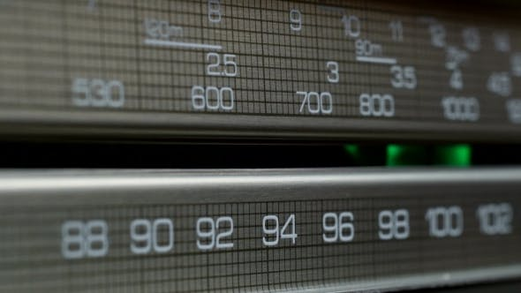
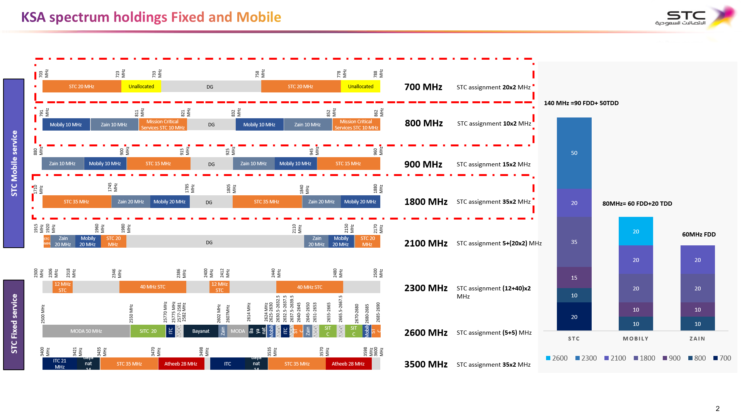
Spectrum Distributions in Saudi Arabia
SM Assignment
Radio channel using spectrum management to manage the signal against interference
Also it is starting from 87.5 MHz to 108 MHz
The same thing in wireless but higher frequency
1800 MHz

Slide 5
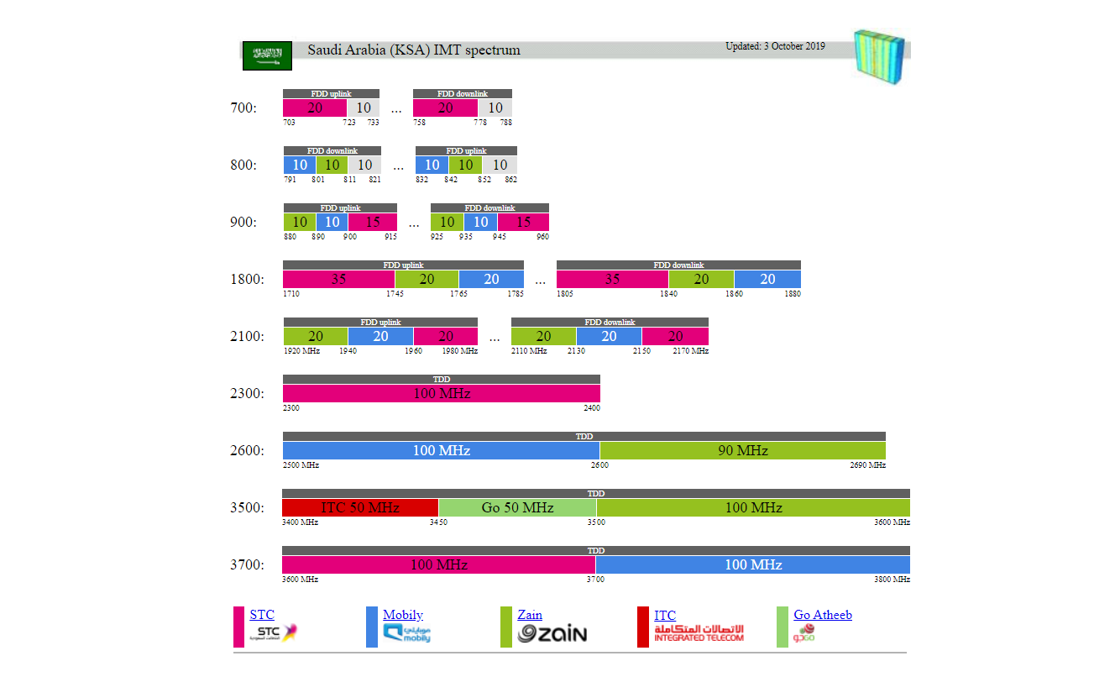





Spectrum Distributions in Saudi Arabia
SM Assignment
700 MHz
800 MHz
900 MHz
1800 MHz
2100 MHz
2300 MHz
20
20
2600 MHz
3500 MHz
3700 MHz

Slide 6
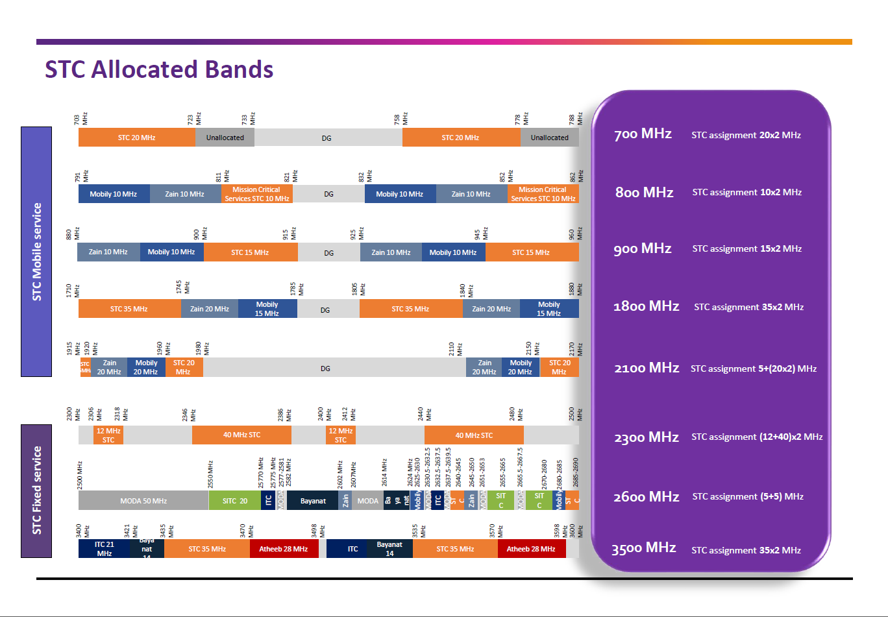
Spectrum Distributions in Saudi Arabia
SM Assignment
20
20

Slide 7
What is the benefits of Spectrum Management?
SM Benefits
SM Benefits
Reduce Interference
Reduce Cost
We will reduce the interference between deferent countries by using agreed international approach
We can lower mobile equipment costs by standardization across technology providers
SM
Benefits
Mobility
Better Economies
If we adopt an agreed international approach it will enable the roaming between countries
Because the same products can be
sold internationally
ITU’s WRC: World Radio communication Conference, every three to four years set to discuss and agree changes to the ‘Radio Regulations’.

Slide 8

Regional Distribution and Interference
International SM
Regional Distribution
ITU divides the world into three regions to have better SM
1 | Region 1 : Europe, Middle East, Africa, Russia and Mongolia
2 | Region 2 : The Americas including Greenland and some of the Eastern pacific Islands
3 | Region 3 : Asia pacific including most of Oceania
Region 1
Region 2
Region 3

Slide 9
Why Operators Looking for More Spectrum?
International SM
Data Growth
There are several important ways that mobile broadband networks
can support more data and achieve faster speeds:
01
New Technology
We can improve the data and achieve faster speed by adding new layers
02
New Sites
We can improve the data and achieve faster speed by adding new sites
03
New Spectrum
We can improve the data and achieve faster speed by adding New frequency

Slide 10

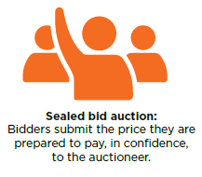
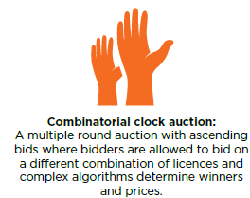
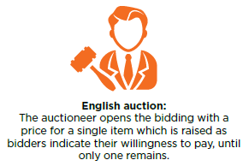
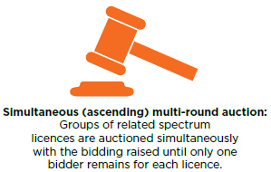
Assigning Spectrum Internationally
International SM
Spectrum Auctions
The commanding method of assigning spectrum licenses to mobile operators is the spectrum auction

Slide 11
National Spectrum Management
National SM
Spectrum Assignment Methods
There are a variety of approaches which regulators can use to exercise different levels of control over how spectrum is assigned
The spectrum commons approach
This method allows anybody to use a certain band without prior permission
Market-based approach
The administrative approach
In this method the regulator has total control, including choosing which companies are assigned spectrum and how it used
This method uses market forces to determine the distribution of spectrum
Like Corona virus how it is pushing the governments to open new spectrums to have more capacity

Slide 12
National Spectrum Management
National SM
Types of Licenses
Before issuing licenses, national governments first need to decide what kind of license to offer for each band
Which permits a specific type of equipment to transmit in a certain area at a specific frequency
Individual License
A new approach that is
generally designed for bands
where there is a lower level of
demand
Licenses Types
Light License
License Exempt or Unlicensed
No license is required
in these bands

Slide 13
National Spectrum Management
National SM
License Terms
Regulators usually specify terms and conditions as part of a spectrum license which typically include:
Type of service that can be provided in a frequency band (e.g. only mobile services);
Technologies that may be used to transmit in the band (e.g. 2G, 3G, 4G or technology
neutral);
In the case of coverage bands (i.e. sub-1 GHz) there may be possible coverage obligations
(e.g. 90 per cent population coverage);
The duration of the license (e.g. 20 years).

Slide 14
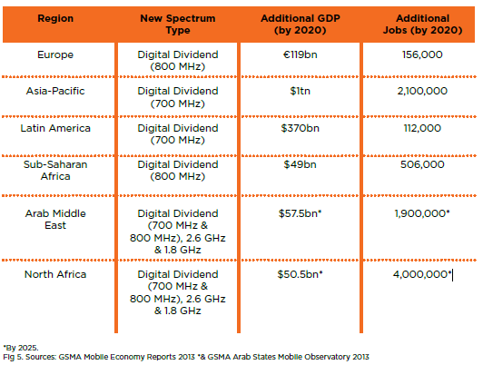
Spectrum Economic Value
Spectrum Economic Value
The economic value of new spectrum
The main way regulators can quickly increase mobile network capacity by assigning spectrum licenses to mobile operators

Slide 15
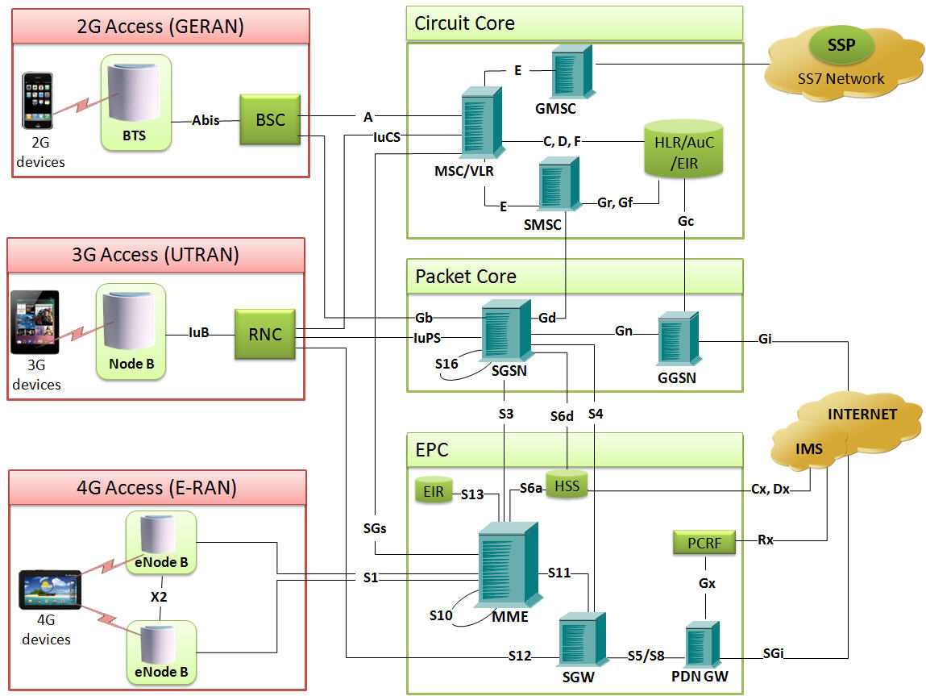
Cellular Network Architecture
Cellular Network
GSM Architecture
UMTS Architecture
LTE Architecture

Slide 16
Cellular Network Architecture
Cellular Network
GSM Architecture
Base Transceiver Station:
  Antenna
  Transceiver (TRX)
  Power amplifier (PA)
  Combiner
  Multiplexer
  Alarm extension system
  Control function
  Baseband receiver unit (BBxx)
Base Station Controller:
  Handling connections & Handover
  Radio Network Management
  Transcoding & Rate adapting
  Traffic concentration
  Transmission management of the BTS
  Remote control of the BTS

Slide 17
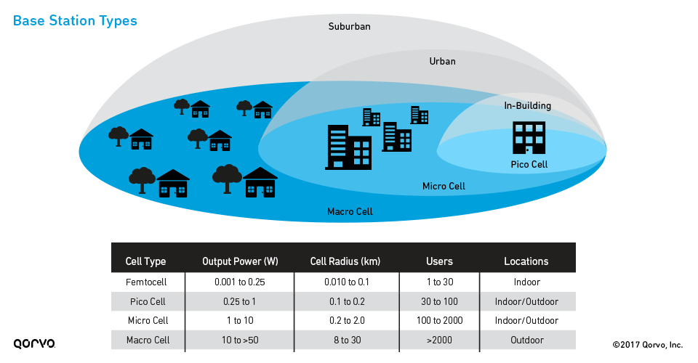
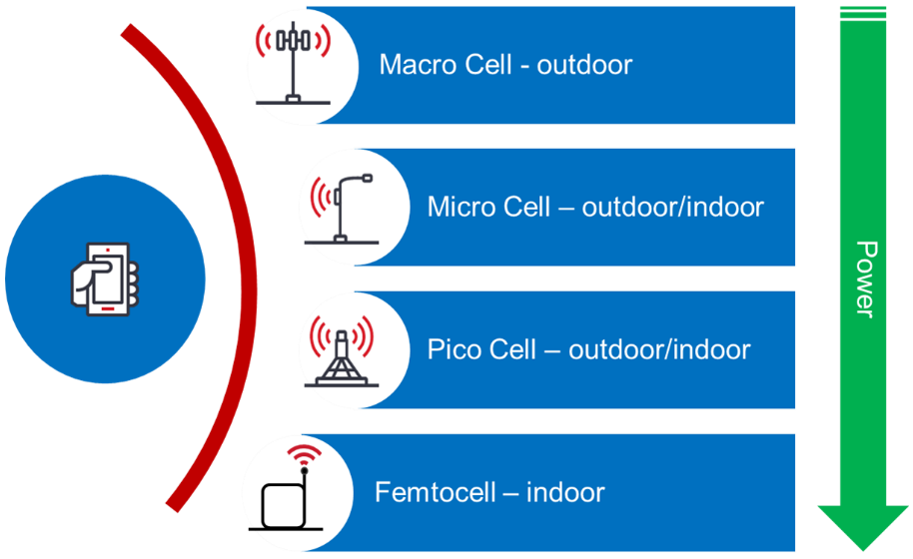
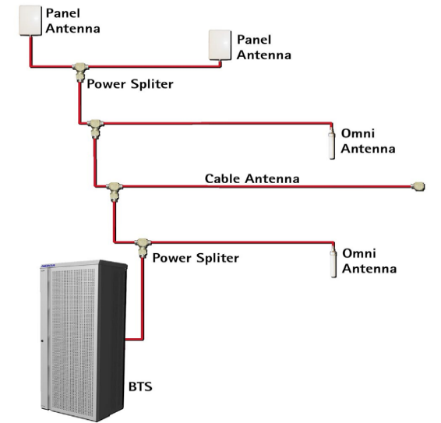
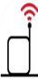
Cellular Network Base Station
Cellular Network
TYPES OF BASE STATION
There are several types of base stations which support to serve the business need based on the consumer type
Propagation Environment
Outdoor
Indoor
Macro cell
DAS
Micro cell
Pico cell
Femto cell

Slide 18
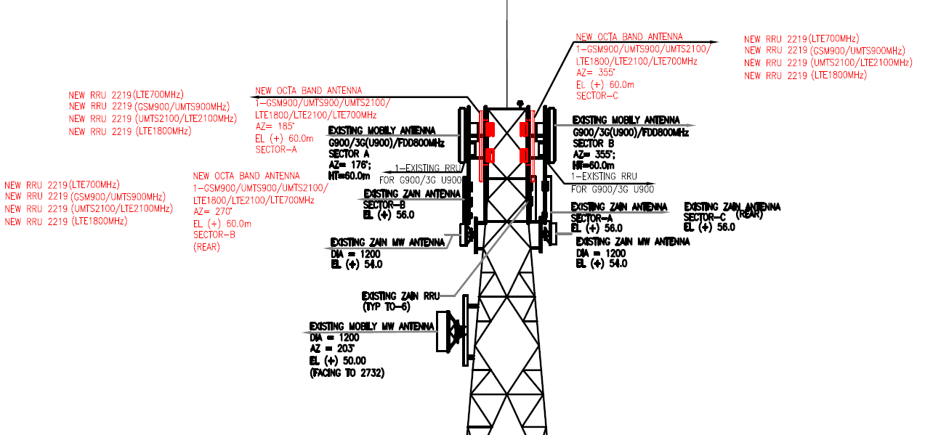
Cellular Network - Study Case
Cellular Network - SC
Sharing Site - Front View

Slide 19
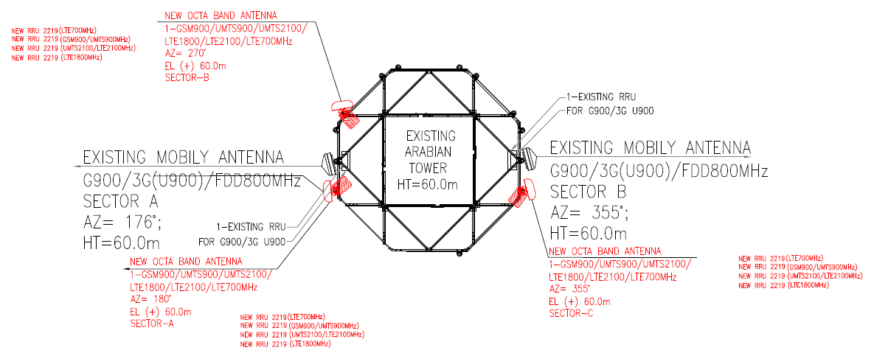
Cellular Network – Study Case
Cellular Network - SC
Sharing Site – Head View

Slide 20



Cellular Network – Study Case
Cellular Network - SC
Sharing Site – Real example

Slide 21



Stay safe,
Stay
Home

Slide 23
International spectrum management
International SM
Different words are used to describe whether a frequency band is available for use by a type of service, a limited range of technologies or a specific company.
Spectrum Legal Language
Allocate
Identify
Allot
Assign
A band is ‘allocated’ for potential use by a certain type of service (e.g. mobile, satellite or broadcasting) by a national regulator, which is contained in the National Frequency Allocation Table (NFAT), or on an international level through the ITU, as detailed in the ‘Radio Regulations’.
A band may then also be ‘identified’ for a limited range of technologies (e.g. a band that is ‘allocated’ to the mobile service will often be ‘identified’ for International Mobile Telecommunications (IMT) which means it can be used by a specific set of compatible mobile technologies, including all 3G and 4G systems).
A less-used term which refers to a decision made at a regional or national level to designate a frequency channel for use by a certain type of service in one or more countries
under certain conditions.
A specific frequency channel is then ‘assigned’ to a specific user by a national government or regulator (e.g. a band may be ‘allocated’ to the mobile service, ‘identified’ for IMT and then split into several sections which are each ‘assigned’ to different mobile operators).

